Slide 1
RISKS OF CHEMICAL RECYCLING
SIDDIKA SULTANA
ESDO
2024

Slide 2
CHEMICAL RECYCLING
OVERVIEW
Converts plastic waste into chemicals or raw materials
METHODS
Utilizes various technologies: solvolysis, liquefaction, pyrolysis, gasification

Slide 3
CHALLENGES
1
2
3
4
Low Viability and Lack of Data
Toxins Inherent in Plastic
Process Emissions and Byproducts
Toxicity of the Resultant Gas, Oil, and Char

Slide 4
ECONOMIC AND ENVIRONMENTAL CONCERNS
CURRENT STATUS
High economic burdens due to input material preparation and product cleaning.
Suitable input materials are limited.
Risks of establishing chemical recycling in countries with poor infrastructure and controls.
Technical feasibility and economic viability not yet proven.
Environmental assessment is ambiguous.
Excessive subsidies for chemical recycling should be avoided to prevent locking in disadvantageous processes.

Slide 5
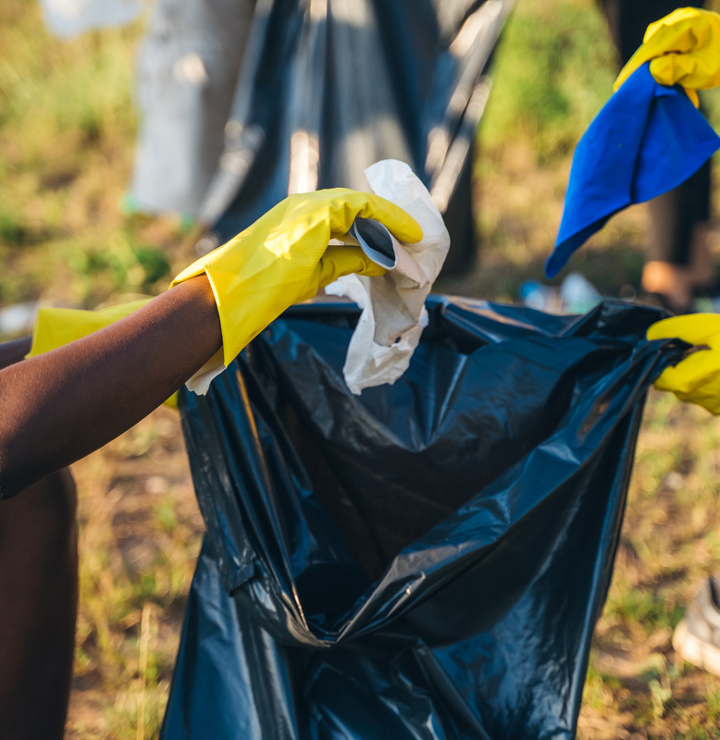
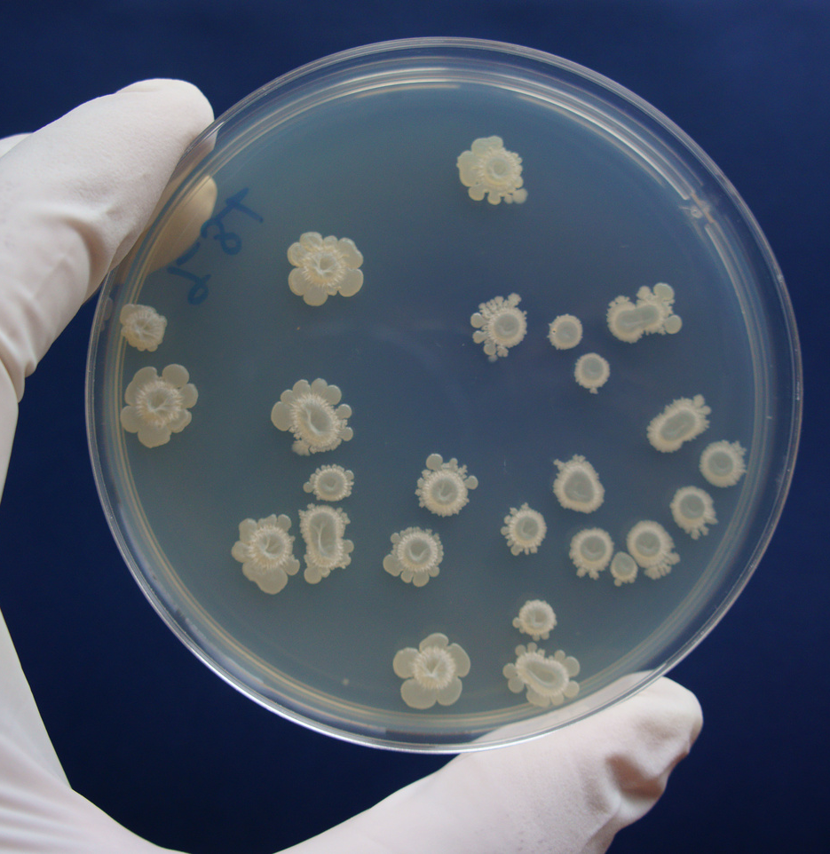
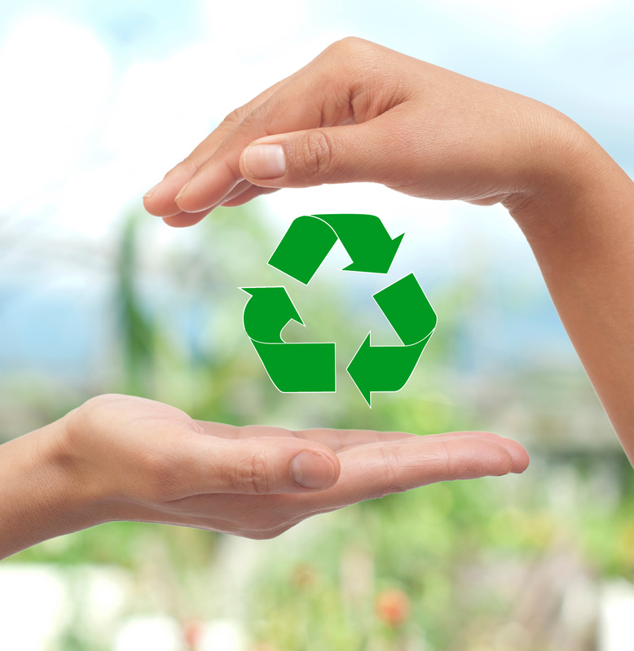
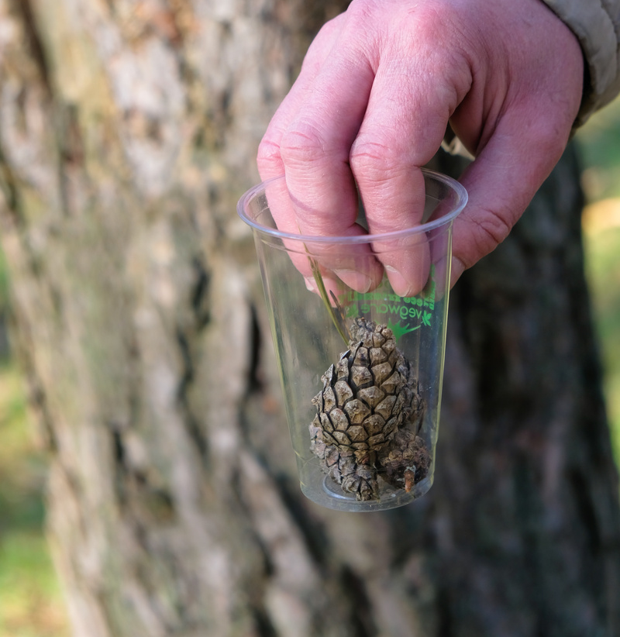
FALSE SOLUTIONS
Clean-up Initiatives
Plastic Eating Bacteria
Recycling
Bio-plastics

Slide 6
THANK YOU!
www.esdo.org

